Slide 1


Complete Guide To React
-Hooks
-React Router
-Redux
Muhammad Talib Waseem
Software Engineer & Instructor

Slide 2
Class Component Vs Functional Component

Slide 3
Syntax
The most obvious one difference is the syntax. A functional component is just a plain JavaScript function which accepts props as an argument and returns a React element.
A class component requires you to extend from React. Component and create a render function which returns a React element. This requires more code but will also give you some benefits which you will see later on.

Slide 4
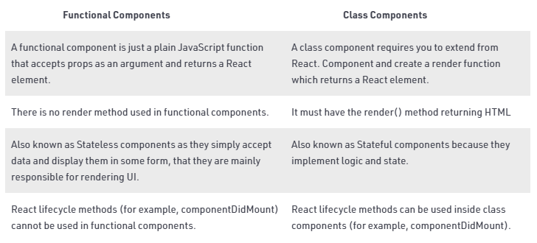

Slide 5


Slide 6
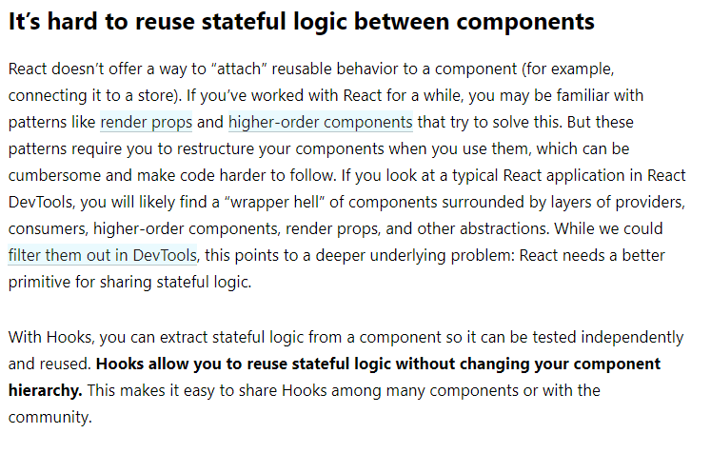

Slide 7
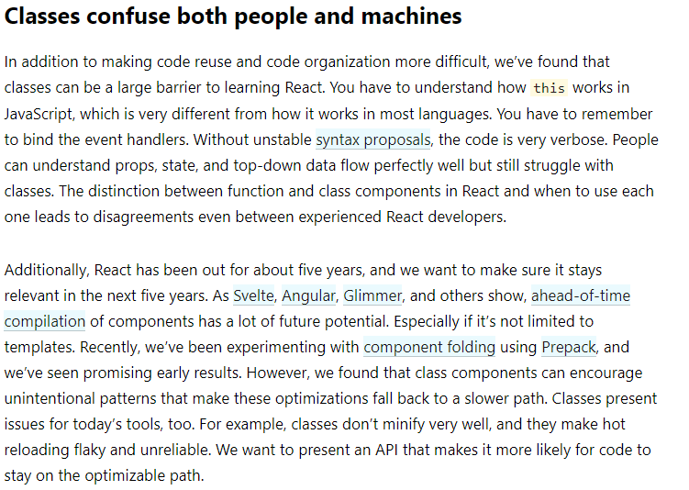

Slide 8
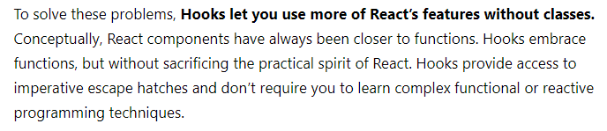

Slide 9


Slide 10
